Slide 1
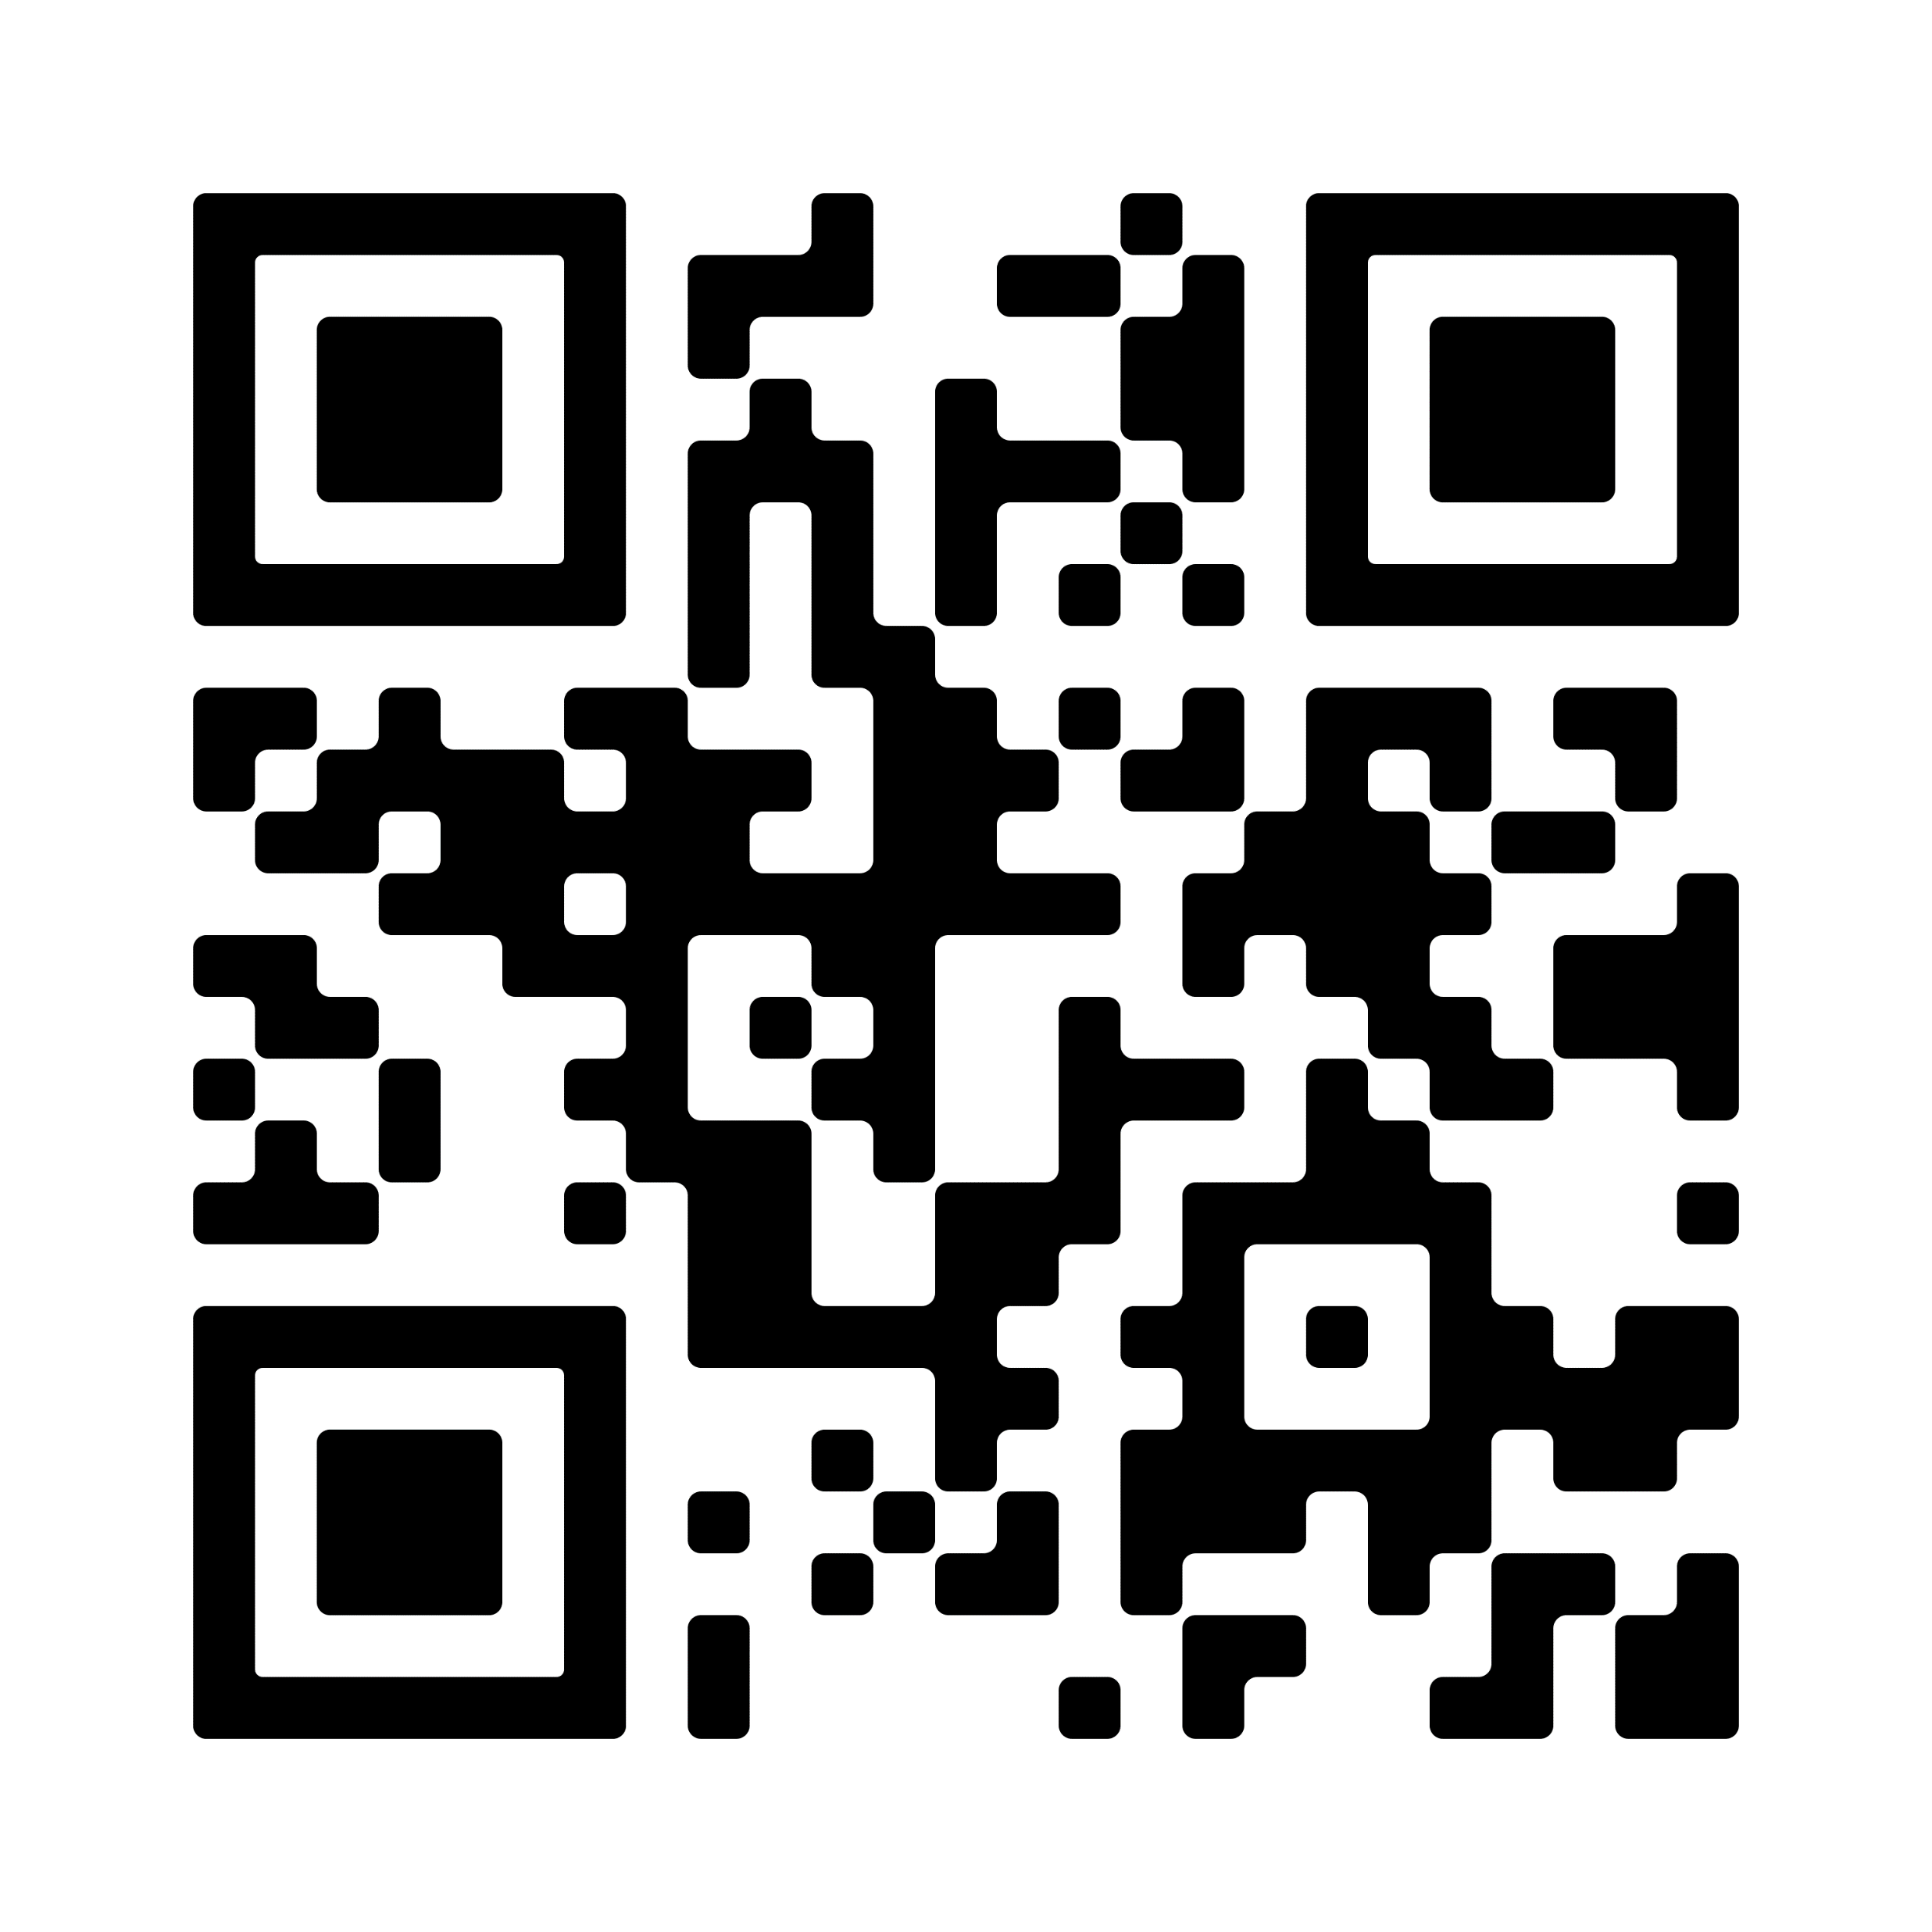
Join The Coding Club
To get on the email list and get more info, scan the QR code to fill out the form
Meetings will be held on Wednesdays at 18:30 in S&E Room 303
All are welcome from the most experienced coders to absolute beginners

